Slide 1


Quantum Traffic Wizards: Grover's Algorithm Unleashed
Uncover the power of Grover's quantum search algorithm and explore how it revolutionizes problem-solving in the realm of quantum computing.
By,
P Sanjeev
192324231

Slide 2
The Challenges of Classical Search Algorithms
Slow Performance
Exponential Growth
Limited Scalability
Classical search algorithms struggle with large datasets.
Search time increases exponentially with problem size.
Classical methods fall short as problems become more complex.

Slide 3

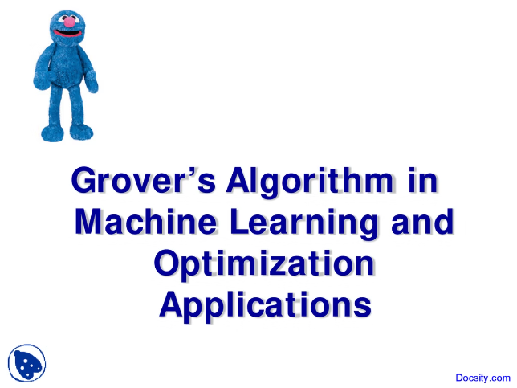
Grover's Algorithm: The Quantum Advantage
1
Quantum Superposition
Enables searching multiple solutions simultaneously.
2
Quantum Interference
Amplifies the desired solution, discarding incorrect ones.
3
Quadratic Speedup
Searches database faster than classical algorithms.

Slide 4
Principles of Grover's Algorithm
1.
Quantum Oracle
3.
Iterative Refinement
Marks the target solution with a phase shift.
Repeating the process boosts the probability of success.
2.
Quantum Diffusion
Amplifies the desired solution through interference.

Slide 5

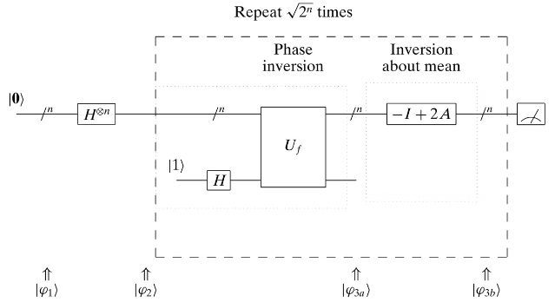
Implementing Grover's Algorithm
Quantum Circuit Design
Translating the algorithm into a working quantum circuit.
Qubit Preparation
Initializing the qubits in the appropriate state.
Iterative Refinement
Performing the oracle and diffusion operations repeatedly.

Slide 6


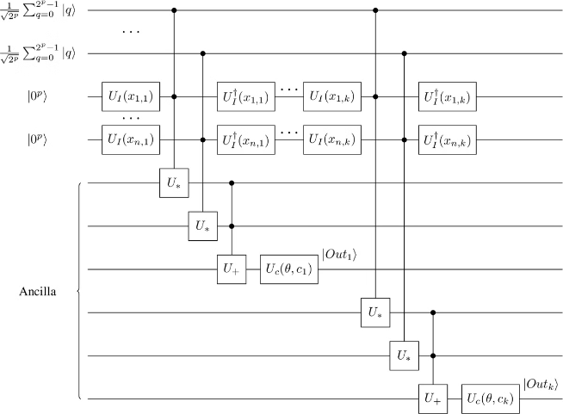

Applications of Grover's Algorithm
Database Search
Finding a specific item in a large database.
Cryptanalysis
Cracking encrypted codes and passwords.
Optimization Problems
Solving complex optimization challenges more efficiently.

Slide 7




Limitations and Considerations
Noise and Decoherence
Scalability Challenges
Algorithmic Constraints
Maintaining quantum state in the face of environmental interference.
Building large-scale quantum computers with many stable qubits.
Identifying problems suitable for quantum speedup with Grover's algorithm.

Slide 8

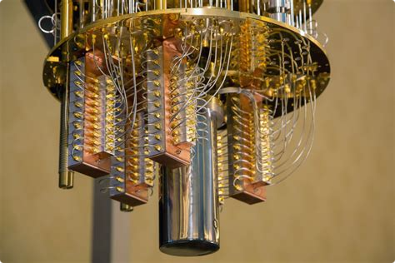
The Future of Quantum Search Algorithms
Continued Algorithm Improvements
Enhancing Grover's algorithm and developing new quantum search methods.
Hardware Advancements
Building larger, more stable quantum computers to unlock new potential.
Real-World Applications
Deploying quantum search algorithms to solve complex problems in industries.

